Slide 1
Introduction to Design Patterns
CS5700 – Object-oriented Software Development

Slide 2
What is a Design Pattern and Why Study Them?
A reusable solution to a commonly occurring problem with a given context
Captures expertise in an accessible and teachable form
Collectively create a high-level lexicon (a vocabulary) for design software system
Help with analysis of problems by documenting common problems
Help with making design choices by explaining consequences of known solutions
Improve productive by encouraging reuse and by providing examples
Encourage more readable and maintainable code by using common terms

Slide 3
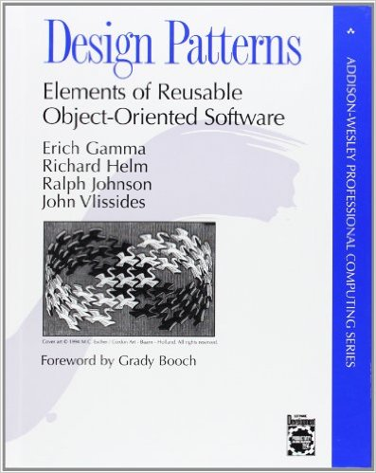
Making Expertise Available
Capturing expertise in patterns originated as an architectural concept (Christopher Alexandar)
The early work in identifying and applying software design patterns first published at the 1987 OOPSLA conference (Kent Beck and Ward Cunningham)
The works started to gain momentum, during a “Bird of Feather” meeting at the OOPSLA conference
A seminal a book was that documented 24 fundamental patterns wasreleased at the 1994 OOPSLA conference (Gang of Four)

Slide 4
The Original Design Patterns
Creational Patterns
Abstract Factory
Builder
Factory Method
Prototype
Singleton
Structural Patterns
Adapter
Bridge
Composite
Decorator
Facade
Flyweight
Proxy
Behavioral Patterns
Chain of Responsibility
Command
Interpreter
Iterator
Mediator
Memento
Observer
State
Strategy
Template Method
Visitor

Slide 5
Pattern Documentation
A documentation template is used to capture each pattern
Essential elements in a pattern template:
Name
Problem description
Context
Other elements
Classification
Intent
Aliases
Motivation
Applicability
Structure
Solution
Consequences
Example of application
Participants
Consequences
Collaborations
Implementation
Sample Code
Known Uses
Related Patterns

Slide 6
Design Pattern Language
A collection on design patterns that work together to help developers follow software engineering principles and apply good practices
A pattern language has a vocabulary, grammar, semantics, and pragmatics
The vocabulary is a collection on named patterns
The grammar (which includes syntax) is embodied in the pattern problem description and solution, which what the essential concepts are and how they fits into a web of other concepts that eventual comprise an entire system
The semantics are captured in the patterns’ solution and examples
The pragmatics are determined the patterns’ context and consequences

Slide 7
Other Pattern Languages
Architectural Design Patterns
User Interface Design Patterns
Patterns for Concurrent, Parallel, and Distributed Systems
Patterns for Simulation Software System
Patterns for System Configuration and Resource Management
Patterns for System Testing
Analysis Patterns
Patterns of Interaction
Workflow Patterns
Patterns for Teaching Object Technology
And many more

